Slide 1
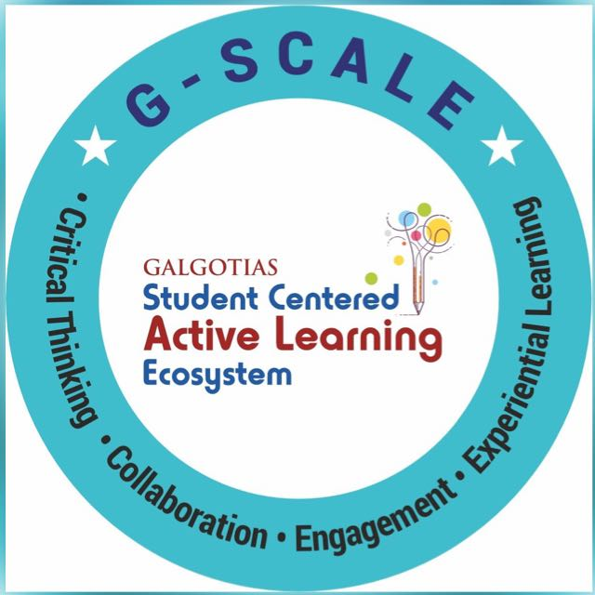
Basic Concepts of Natural Language Processing Session No.: 1 Course Name: Natural Language Processing Course Code: R1UC616C Instructor Name: Mr. Amit Yadav Duration: 50 mins Date of Conduction of Class:

Slide 2
How a voice-activated assistant like Siri or Alexa understands and responds to your commands.

Slide 3
At the end of this session, students will be able to
Explain the fundamental concepts of Natural Language Processing (NLP) and its relationship with computational linguistics, highlighting their role in human-machine communication.

Slide 4



What is Natural Language Processing (NLP)?

Slide 5
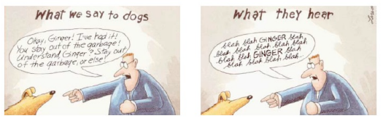
Go beyond the keyword matching
Identify the structure and meaning of
words, sentences, texts and conversations
Deep understanding of broad language
NLP is all around us

Slide 6
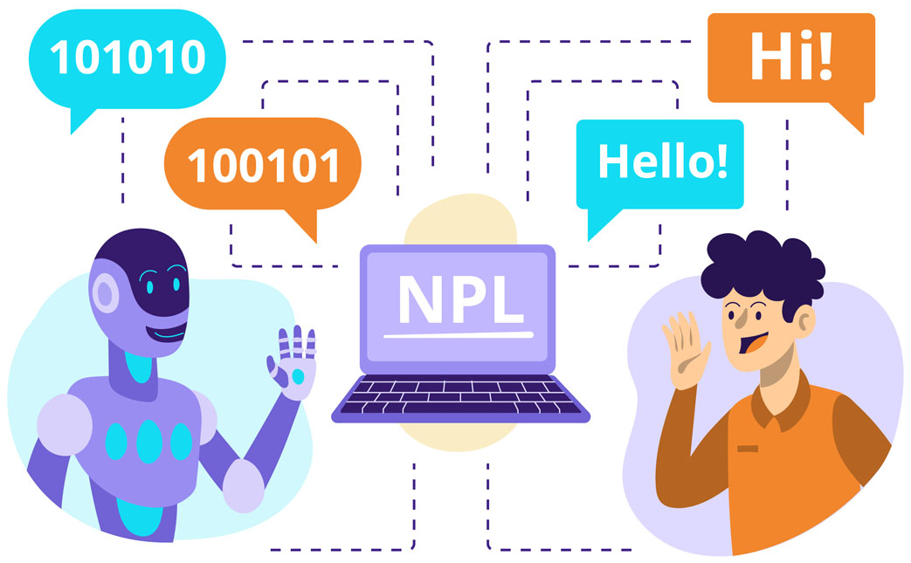
Natural Language Processing vs Computational Linguistics
NLP is an engineering discipline that seeks to improve human-human, human-machine, machine-machine communication by developing appropriate systems.
Computational linguistics is the study of language using computers

Slide 7
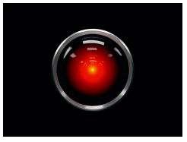
Example: Conversational Agent
HAL is an artificial agent capable of such advanced
language-processing behavior as speaking and understanding
English, and at a crucial moment in the plot, even reading lips
2001: A Space Odyssey – HAL 9000
https://www.youtube.com/watch?v=HwBmPiOmEGQ&feature=youtu.be

Slide 8
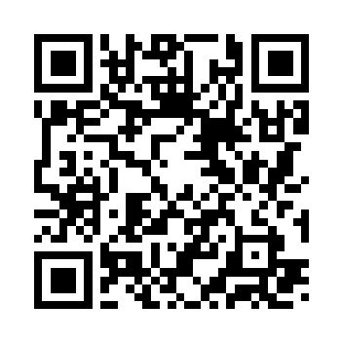
Learning Activity 1:
Give your observations after seeing the video
What are the different technologies that conversational agents contain?
What does HAL need?
Go to wooclap.com
Enter the event code in the top banner
Event code
NLPL1

Slide 9
Reflection- Learning Activity: Give your observations after seeing the video

Slide 10
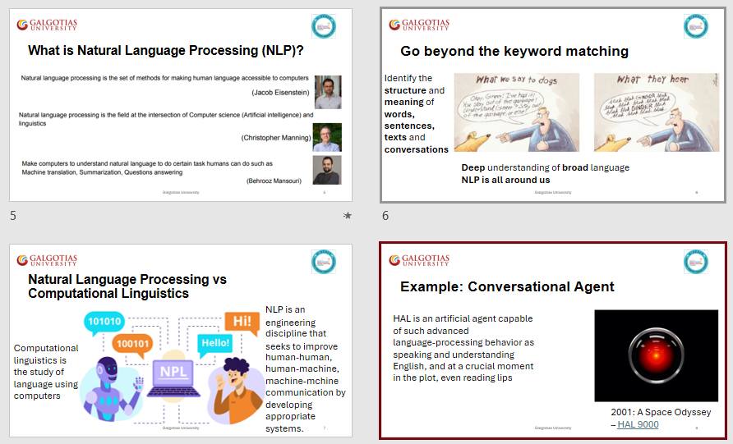
Summary

Slide 11

Ensure attainment of LOs in alignment to the learning activities: outcomes (1-2)
Outcome 1: Explain the Fundamental Concepts of NLP and Its Relationship with Computational Linguistics (Collaborative Learning Groups)

Slide 12
Information to next topic of the course
Next Lecture: Components of NLP

Slide 13


Review and Reflection from students

